Slide 1
Home
Special
Order
Account
Comment
CHOC O LAT

Slide 2
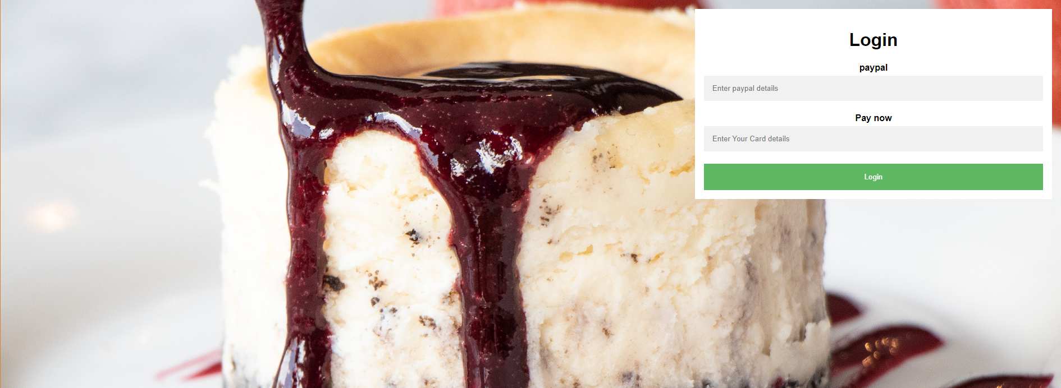

Slide 3


Slide 4
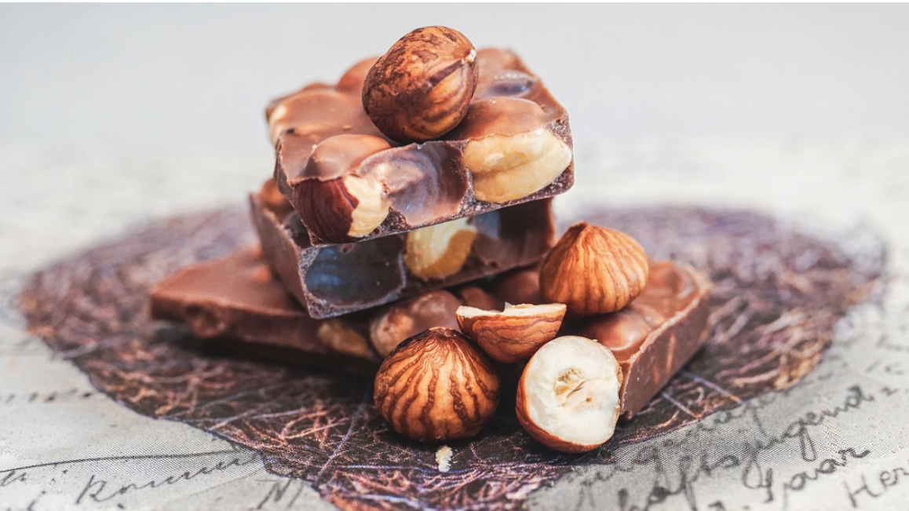
Name
Points credit
Surname
Click for advise your website to someone
Email

Slide 5


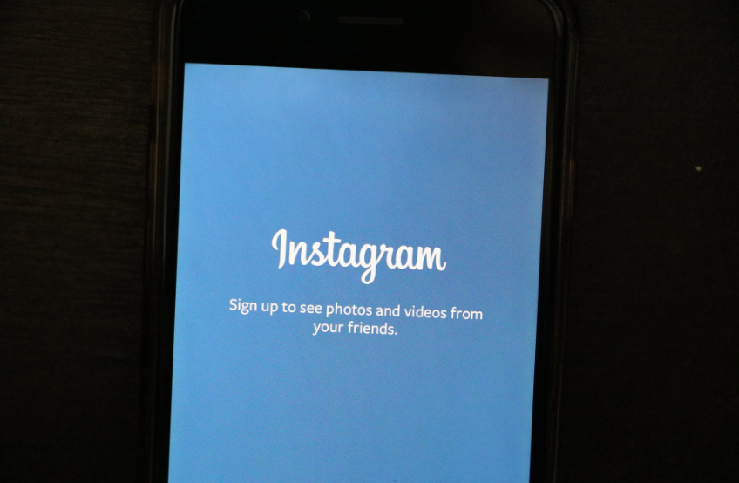


Email: cholatetaste@gmail.com
Address:Ashton Underlyne M11 27W
Telephone: 07451864828

